Slide 1

Longfin Power Sequence Testing

Slide 2
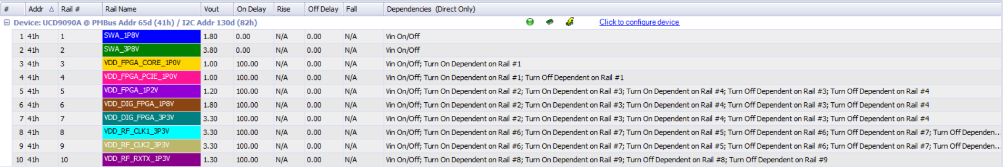
Rail Tree Dependencies

Slide 3
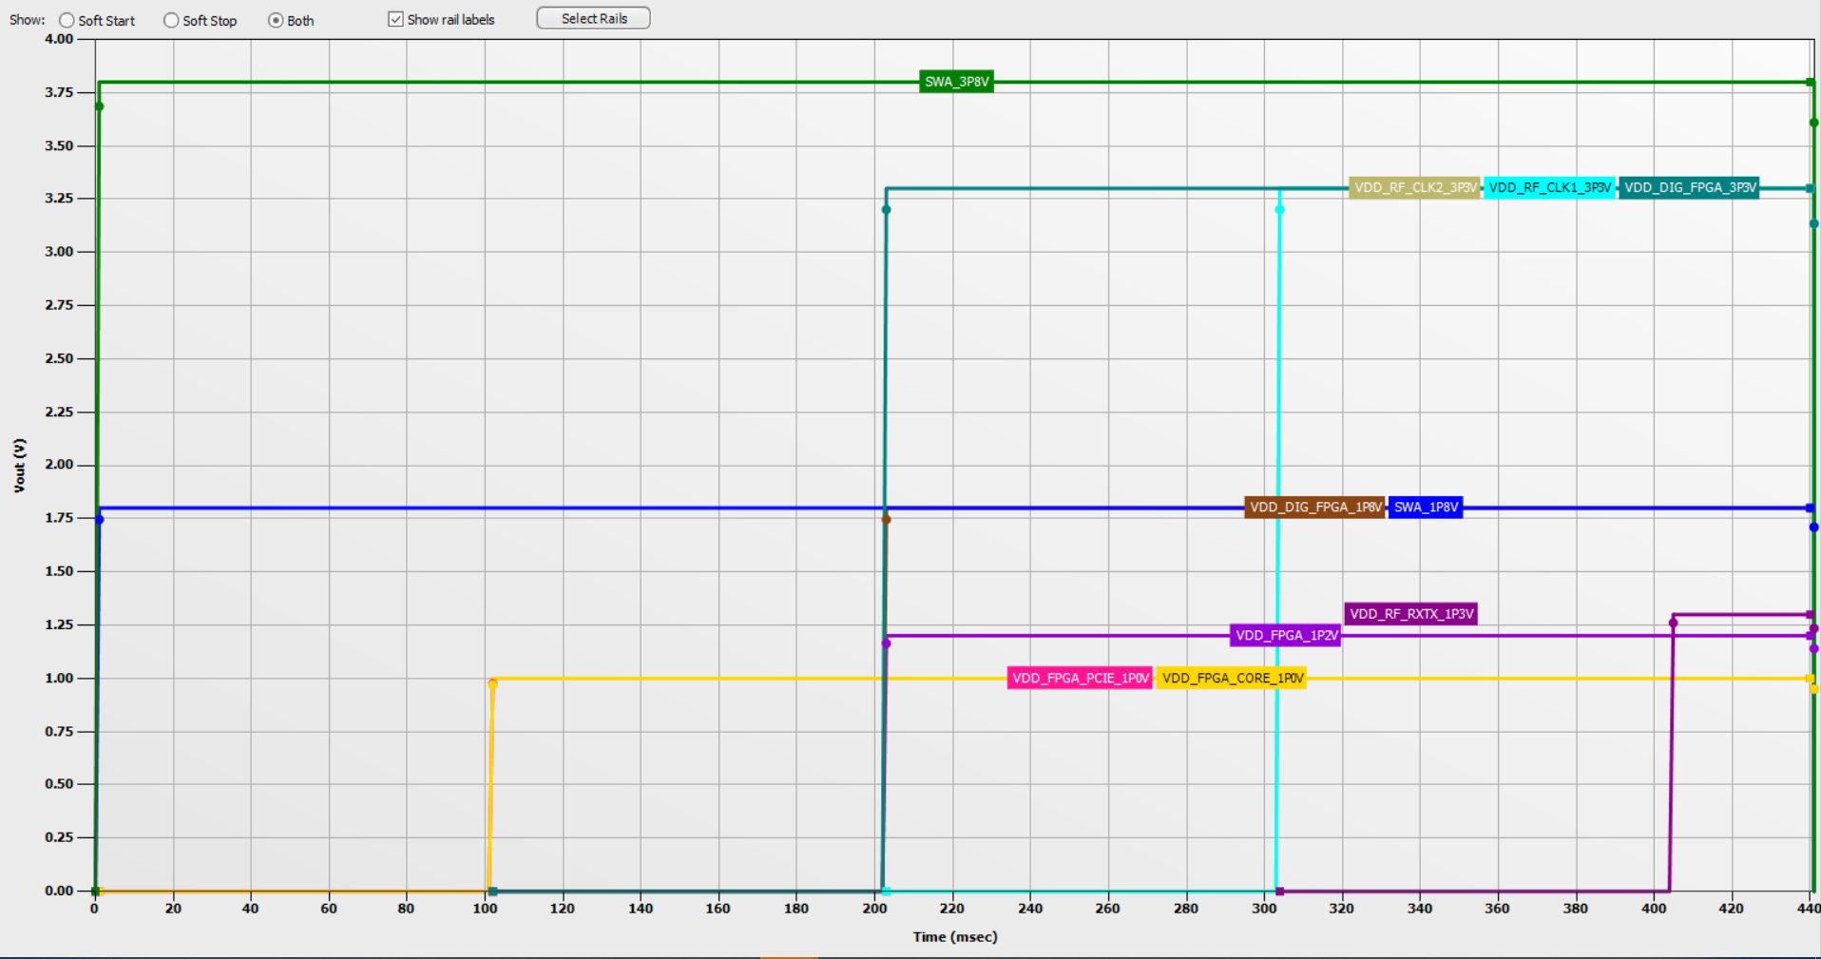
Sequencing On and Off Timing: Vout Over Time

Slide 4
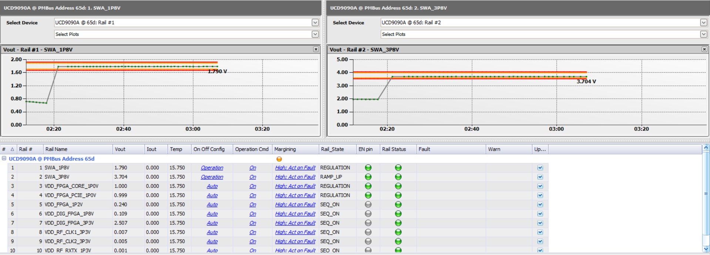
Initial Problem: Vout Less than Power_Good_oN

Slide 5
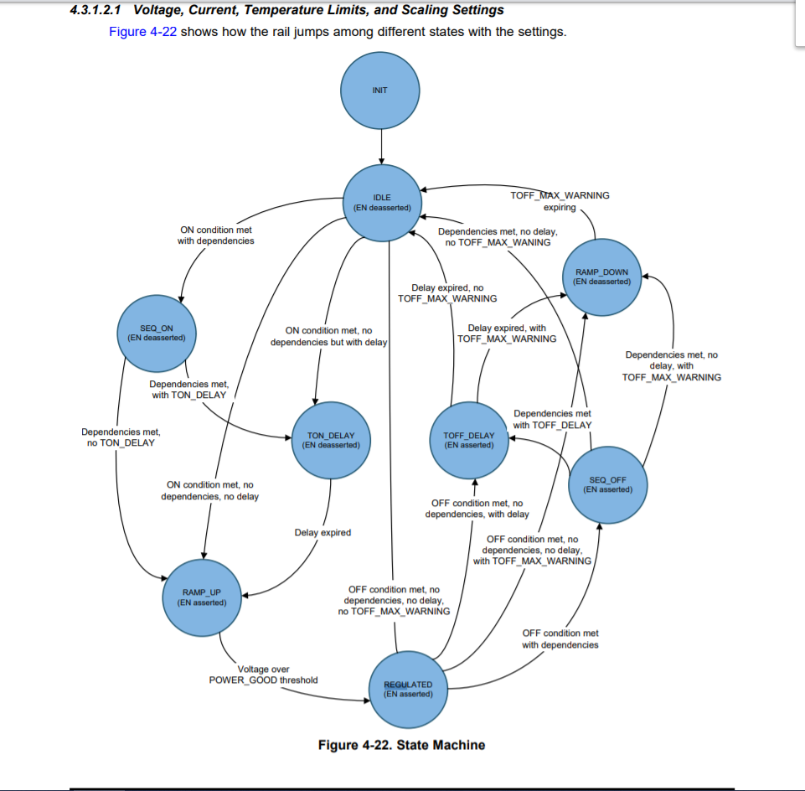
State Machine

Slide 6
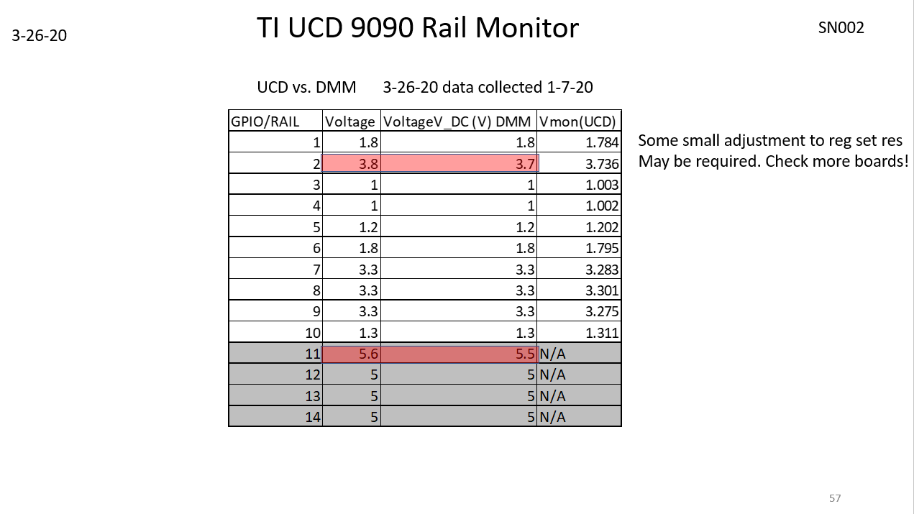
Expected Voltage VS. Measured Voltage (Measure by DMM and UCD9090

Slide 7
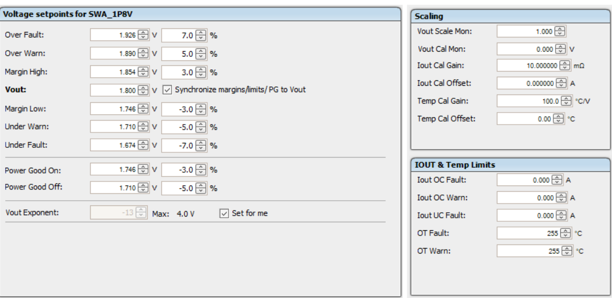
Voltage Setpoint Formula: Power_Good_On Set at -5% Window and Power_Good_Off Set to be at 3% Window

Slide 8
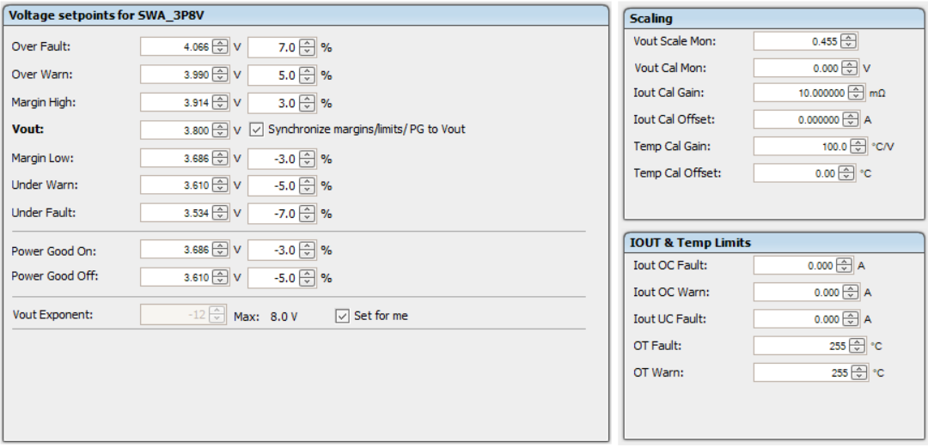
Rail 2

Slide 9
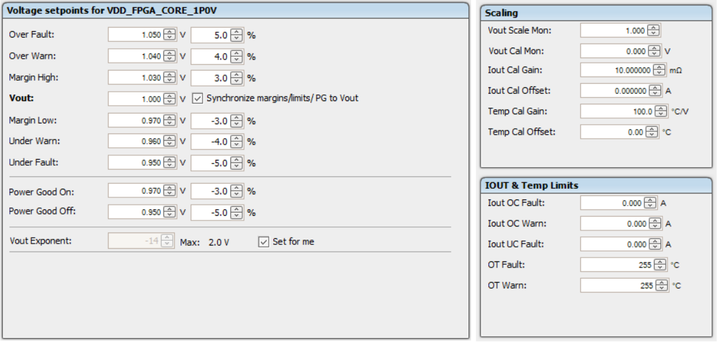
Rail 3

Slide 10
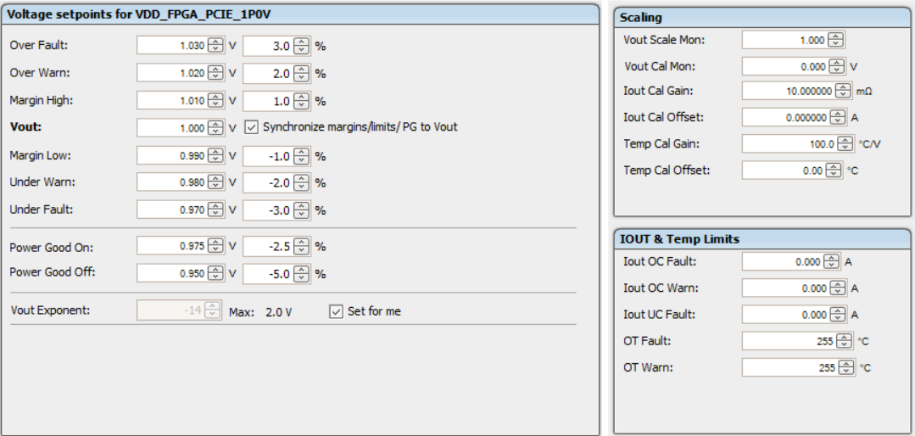
Rail 4

Slide 11
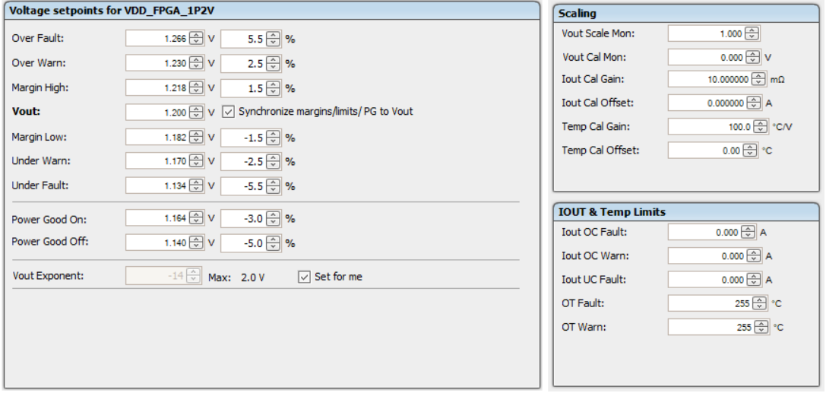
Rail 5

Slide 12
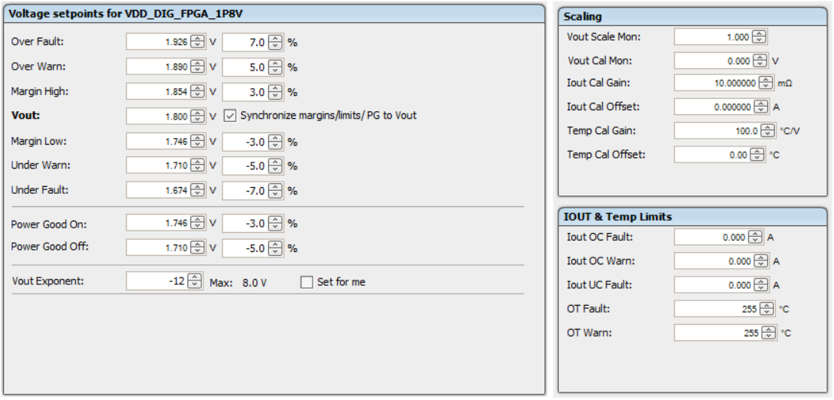
Rail 6

Slide 13
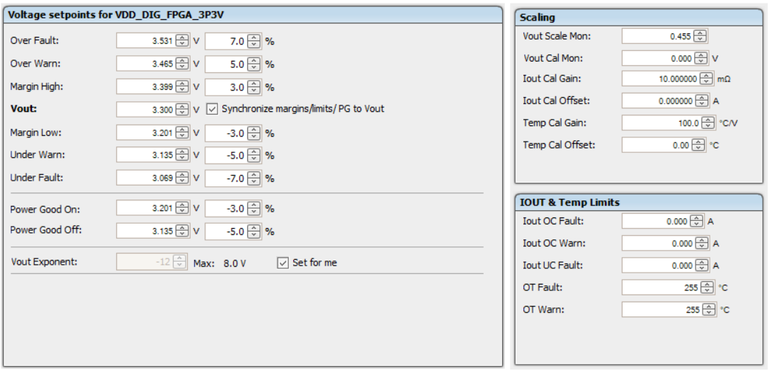
Rail 7

Slide 14

Rail 8

Slide 15
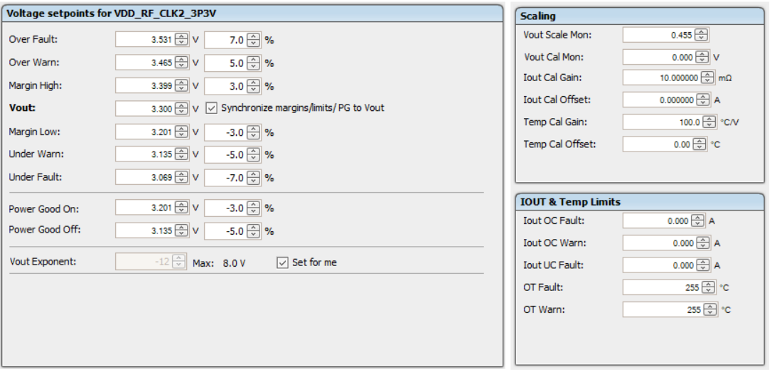
Rail 9

Slide 16

Rail 10

Slide 17
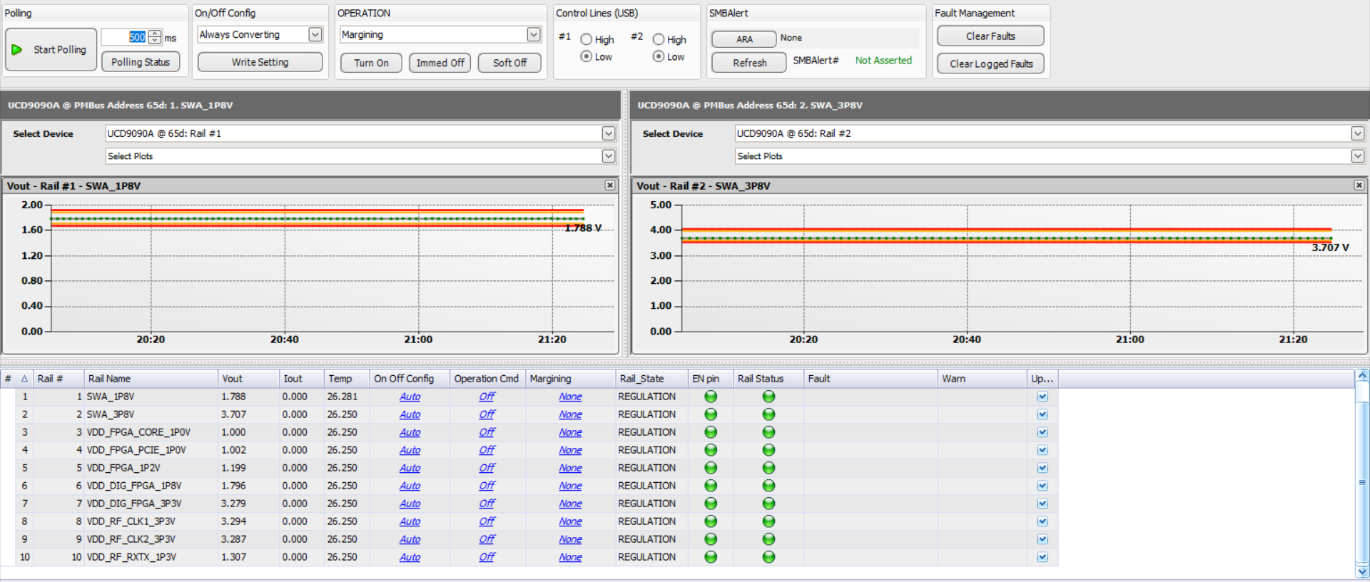
Final Sequencing After Configuring Vout to be Greater Than Power_Good_On

Slide 18
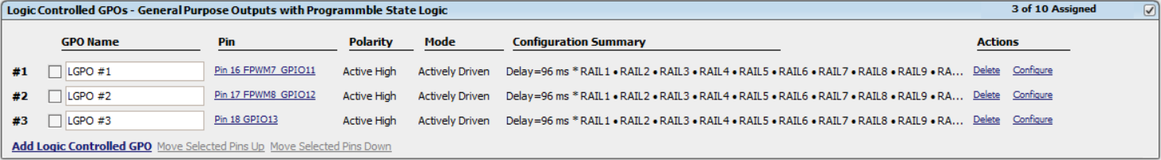
Enable Connections and Configurations

Slide 19
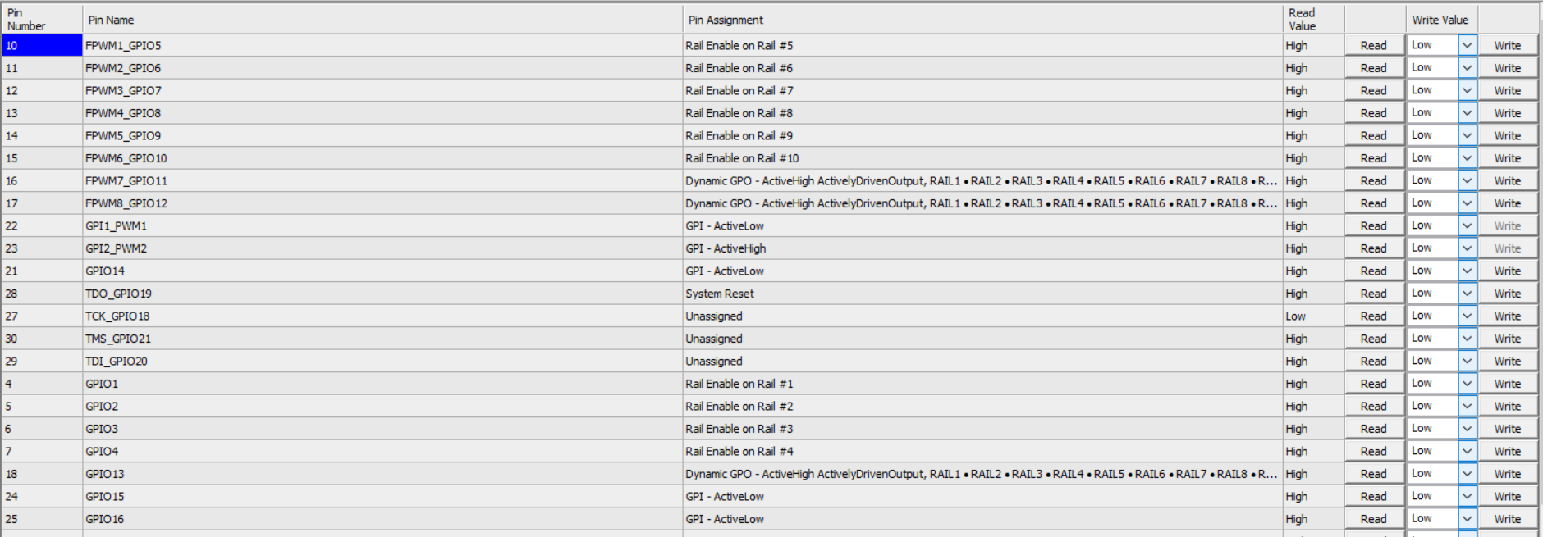

Slide 20
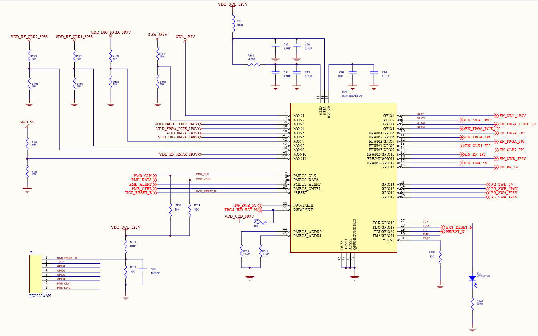
WatchDog and External Reset

Slide 21
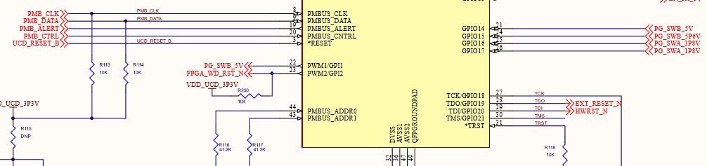
Close Up Image of WatchDog and External Reset

Slide 22
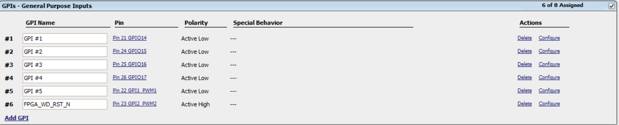
GPI Pin Connections

Slide 23
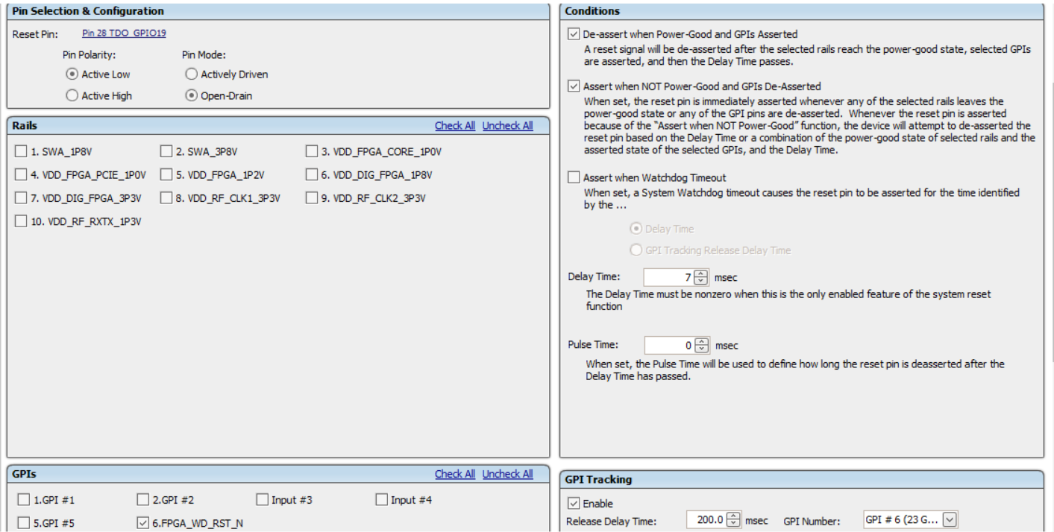
System Reset Configuration

Slide 24
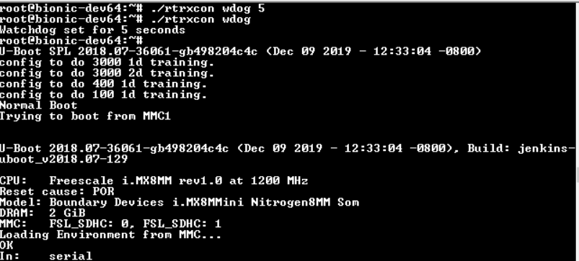
Longfin External Reset Execution

Slide 25
Instructions On Programming the UCD9090
Click on image below for PDF

